Slide 1
HealthLog – Progress Report
Name :WANG ZUZAN
Student ID : c3552364
Module:INFT 2051

Slide 2
APP Purpose
HealthLog is a mobile app to help users track their daily food.
Users can enter food and get simple nutrition information, such as calories, protein, carbs, and fat.
The goal is to help users understand their eating habits and improve their health.

Slide 3
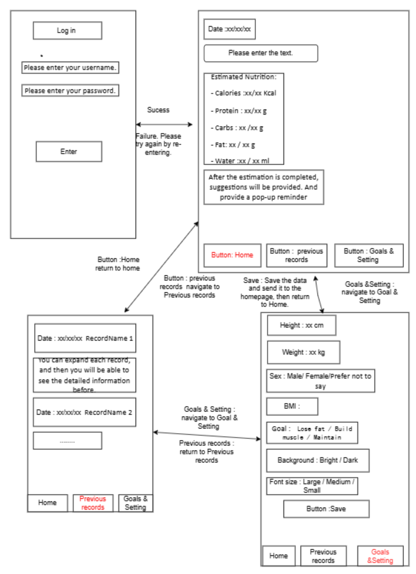
Core Functionality
Core Functionality
1.Set ideal nutrition intake based on user profile
2.Allow users to enter multiple foods for total nutrition estimation
3.Compare actual intake with ideal nutrition goals
4.Provide reminders based on nutrition results

Slide 4
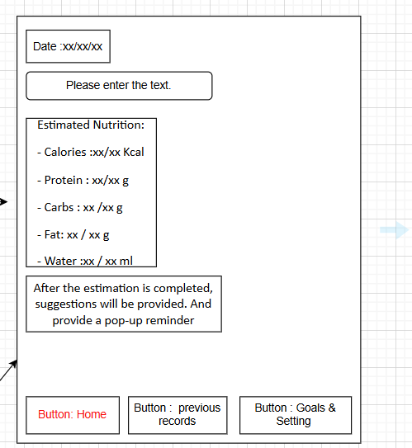
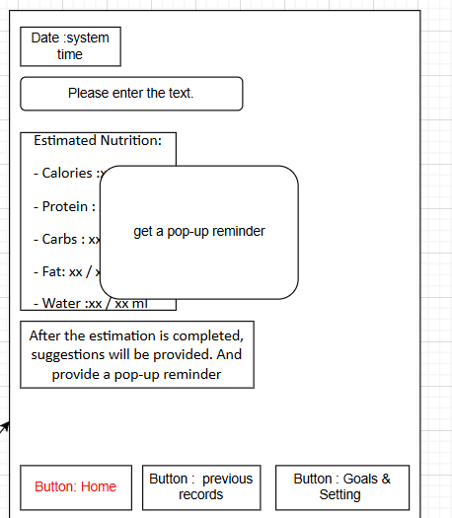
Design Improvement
Before:
1.Static date
2.No feedback message
Updated:
1.Dynamic system date
2.Pop-up reminder added

Slide 5

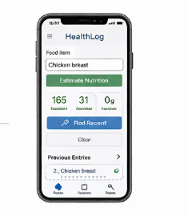
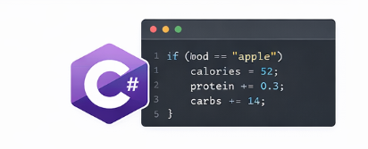
External Technologies Used
1.SQLite – store user records
2..NET MAUI – build mobile UI
3.C# – implement logic

Slide 6

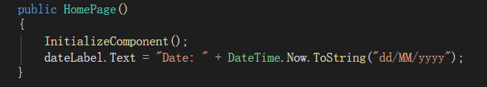
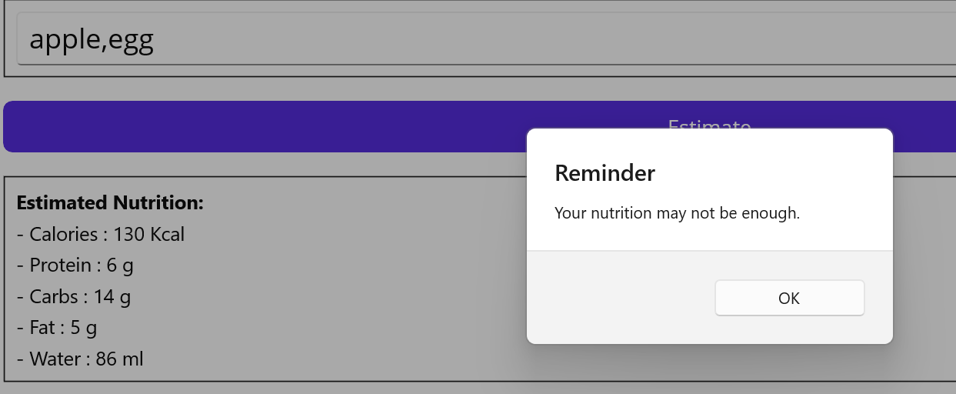
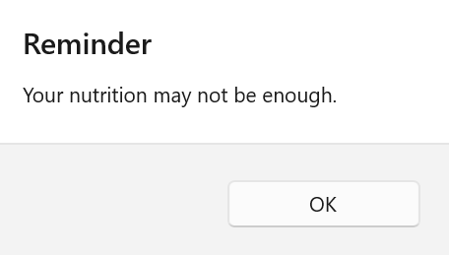
Technical Difficulties & Solutions
1. Database storage → Use SQLite
2. Date synchronization → Use system time
3. Multiple food input → Combine inputs and calculate total
4. User feedback → Use pop-up messages

Slide 7

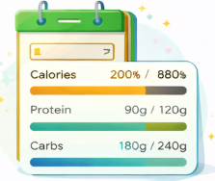
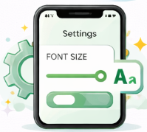
Action Plan
1.Add more common food data for better input
2.Implement Goals feature to customise nutrition targets
3.Allow users to adjust font size in settings

Slide 8
Project Difficulties
Difficulties:
1.Limited time for development
2.Learning SQLite
3.Managing multiple features
Solutions:
1.Focus on core functions first
2.Learn through practice
3.Gradual implementation

Slide 9
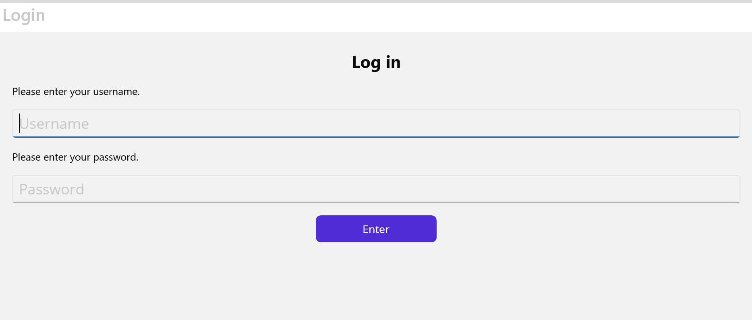
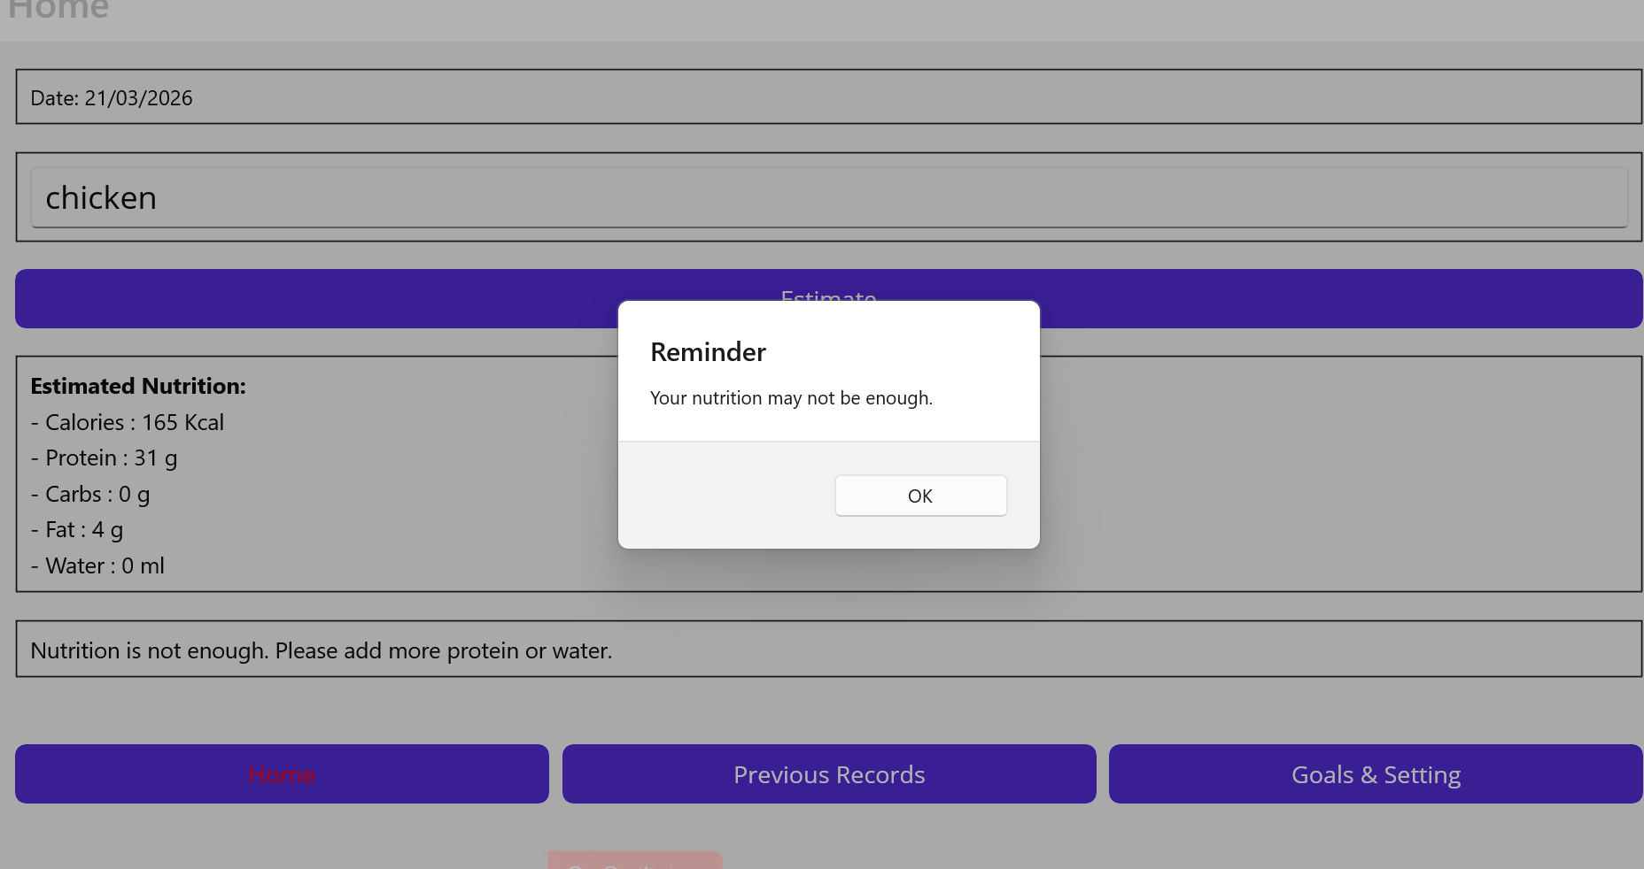
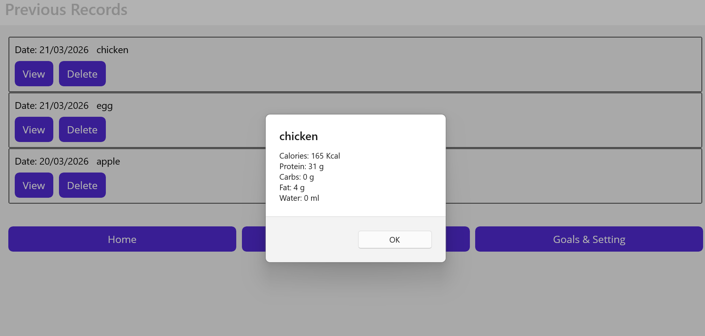
Code Demonstration
Current features:
- User login page
- Three kinds of food input and nutrition estimation(apple,egg,chicken)
- Pop-up reminder messages
- View & delete records

Slide 10
Usability Testing
What we tested:
1.Food input
2.Navigation
3.Record viewing
Findings:
1.Easy to use
2.Some confusion with multiple food input
Improvements:
1.Simplified input
2.Added feedback messages

Slide 11
Summary
The system can estimate nutrition and store user records
It helps users understand their daily intake
The interface is simple and easy to use
Future improvements will enhance functionality and user experience
Thank you

